Slide 1
Productionizing Spark and the Spark REST Job Server
Evan Chan
Distinguished Engineer @TupleJump

Slide 2
Who am I
Distinguished Engineer, Tuplejump
@evanfchan
http://github.com/velvia
User and contributor to Spark since 0.9
Co-creator and maintainer of Spark Job Server

Slide 3
TupleJump
Tuplejump is a big data technology leader providing solutions and development partnership.
FiloDB - Spark-based analytics database for time series and event data (github.com/tuplejump/FiloDB)
Calliope - the first Spark-Cassandra integration
Stargate - an open source Lucene indexer for Cassandra
SnackFS - open source HDFS for Cassandra

Slide 4

TupleJump - Big Data Dev Partners

Slide 5
Deploying Spark

Slide 6
Choices, choices, choices
YARN, Mesos, Standalone?
With a distribution?
What environment?
How should I deploy?
Hosted options?
What about dependencies?
Notes:
There are many ways to run Spark. There is a standalone cluster mode, and it can run under Mesos, or YARN.

Slide 7
Basic Terminology
The Spark documentation is really quite good.
Notes:
There are many ways to run Spark. There is a standalone cluster mode, and it can run under Mesos, or YARN.

Slide 8
What all the clusters have in common
YARN, Mesos, and Standalone all support the following features:
Running the Spark driver app in cluster mode
Restarts of the driver app upon failure
UI to examine state of workers and apps
Notes:
There are many ways to run Spark. There is a standalone cluster mode, and it can run under Mesos, or YARN.

Slide 9
Spark Standalone Mode
The easiest clustering mode to deploy**
Use make-distribution.sh to package, copy to all nodes
sbin/start-master.sh on master node, then start slaves
Test with spark-shell
HA Master through Zookeeper election
Must dedicate whole cluster to Spark
In latest survey, used by almost half of Spark users
Notes:
There are many ways to run Spark. There is a standalone cluster mode, and it can run under Mesos, or YARN.

Slide 10
Apache Mesos
Was started by Matias in 2007 before he worked on Spark!
Can run your entire company on Mesos, not just big data
Great support for micro services - Docker, Marathon
Can run non-JVM workloads like MPI
Commercial backing from Mesosphere
Heavily used at Twitter and AirBNB
The Mesosphere DCOS will revolutionize Spark et al deployment - “dcos package install spark” !!
Notes:
There are many ways to run Spark. There is a standalone cluster mode, and it can run under Mesos, or YARN.

Slide 11
Mesos vs YARN
Mesos is a two-level resource manager, with pluggable schedulers
You can run YARN on Mesos, with YARN delegating resource offers to Mesos (Project Myriad)
You can run multiple schedulers within Mesos, and write your own
If you’re already a Hadoop / Cloudera etc shop, YARN is easy choice
If you’re starting out, go 100% Mesos
Notes:
There are many ways to run Spark. There is a standalone cluster mode, and it can run under Mesos, or YARN.

Slide 12
Mesos Coarse vs Fine-Grained
Spark offers two modes to run Mesos Spark apps in (and you can choose per driver app):
coarse-grained: Spark allocates fixed number of workers for duration of driver app
fine-grained (default): Dynamic executor allocation per task, but higher overhead per task
Use coarse-grained if you run low-latency jobs
Notes:
There are many ways to run Spark. There is a standalone cluster mode, and it can run under Mesos, or YARN.

Slide 13
What about Datastax DSE?
Cassandra, Hadoop, Spark all bundled in one distribution, collocated
Custom cluster manager and HA/failover logic for Spark Master, using Cassandra gossip
Can use CFS (Cassandra-based HDFS), SnackFS, or plain Cassandra tables for storage
or use Tachyon to cache, then no need to collocate (use Mesosphere DCOS)
Notes:
There are many ways to run Spark. There is a standalone cluster mode, and it can run under Mesos, or YARN.

Slide 14
Hosted Apache Spark
Spark on Amazon EMR - first class citizen now
Direct S3 access!
Google Compute Engine - “Click to Deploy” Hadoop+Spark
Databricks Cloud
Many more coming
What you notice about the different environments:
Everybody has their own way of starting: spark-submit vs dse spark vs aws emr … vs dcos spark …
Notes:
There are many ways to run Spark. There is a standalone cluster mode, and it can run under Mesos, or YARN.

Slide 15

Mesosphere DCOS
Automates deployment to AWS, Google, etc.
Common API and UI, better cost and control, cloud
Load balancing and routing, Mesos for resource sharing
dcos package install spark
Notes:
There are many ways to run Spark. There is a standalone cluster mode, and it can run under Mesos, or YARN.

Slide 16
Configuring Spark

Slide 17
Building Spark
Make sure you build for the right Hadoop version
eg mvn -Phadoop-2.2 -Dhadoop.version=2.2.0 -DskipTests clean package
Make sure you build for the right Scala version - Spark supports both 2.10 and 2.11
Notes:
There are many ways to run Spark. There is a standalone cluster mode, and it can run under Mesos, or YARN.

Slide 18
Jars schmars
Dependency conflicts are the worst part of Spark dev
Every distro has slightly different jars - eg CDH < 5.4 packaged a different version of Akka
Leave out Hive if you don’t need it
Use the Spark UI “Environment” tab to check jars and how they got there
spark-submit —jars / —packages forwards jars to every executor (unless it’s an HDFS / HTTP path)
Spark-env.sh SPARK_CLASSPATH - include dep jars you’ve deployed to every node
Notes:
There are many ways to run Spark. There is a standalone cluster mode, and it can run under Mesos, or YARN.

Slide 19
Jars schmars
You don’t need to package every dependency with your Spark application!
spark-streaming is included in the distribution
spark-streaming includes some Kafka jars already
etc.
Notes:
There are many ways to run Spark. There is a standalone cluster mode, and it can run under Mesos, or YARN.

Slide 20
ClassPath Configuration Options
spark.driver.userClassPathFirst, spark.executor.userClassPathFirst
One way to solve dependency conflicts - make sure YOUR jars are loaded first, ahead of Spark’s jars
Client mode: use spark-submit options
—driver-class-path, —driver-library-path
Spark Classloader order of resolution
Classes specified via —jars, —packages first (if above flag is set)
Everything else in SPARK_CLASSPATH
Notes:
There are many ways to run Spark. There is a standalone cluster mode, and it can run under Mesos, or YARN.

Slide 21
Some useful config options
spark.serializer | org.apache.spark.serializer.KryoSerializer
spark.default.parallelism | or pass # partitions for shuffle/reduce tasks as second arg
spark.scheduler.mode | FAIR - enable parallelism within apps (multi-tenant or low-latency apps like SQL server)
spark.shuffle.memoryFraction, spark.storage.memoryFraction | Fraction of Java heap to allocate for shuffle and RDD caching, respectively, before spilling to disk
spark.cleaner.ttl | Enables periodic cleanup of cached RDDs, good for long-lived jobs
spark.akka.frameSize | Increase the default of 10 (MB) to send back very large results to the driver app (code smell)
spark.task.maxFailures | # of retries for task failure is this - 1
Notes:
There are many ways to run Spark. There is a standalone cluster mode, and it can run under Mesos, or YARN.

Slide 22
Control Spark SQL Shuffles
By default, Spark SQL / DataFrames will use 200 partitions when doing any groupBy / distinct operations
sqlContext.setConf( "spark.sql.shuffle.partitions", "16")
Notes:
There are many ways to run Spark. There is a standalone cluster mode, and it can run under Mesos, or YARN.

Slide 23
Prevent temp files from filling disks
(Spark Standalone mode only)
spark.worker.cleanup.enabled = true
spark.worker.cleanup.interval
Configuring executor log file retention/rotation
spark.executor.logs.rolling.maxRetainedFiles = 90
spark.executor.logs.rolling.strategy = time
Notes:
There are many ways to run Spark. There is a standalone cluster mode, and it can run under Mesos, or YARN.

Slide 24
Tuning Spark GC
Lots of cached RDDs = huge old gen GC cycles, stop-the-world GC
Know which operations consume more memory (sorts, shuffles)
Try the new G1GC … avoids whole-heap scans
-XX:+UseG1GC
https://databricks.com/blog/2015/05/28/tuning-java-garbage-collection-for-spark-applications.html
Notes:
There are many ways to run Spark. There is a standalone cluster mode, and it can run under Mesos, or YARN.

Slide 25
Running Spark Applications

Slide 26
Run your apps in the cluster
spark-submit: —deploy-mode cluster
Spark Job Server: deploy SJS to the cluster
Drivers and executors are very chatty - want to reduce latency and decrease chance of networking timeouts
Want to avoid running jobs on your local machine
Notes:
There are many ways to run Spark. There is a standalone cluster mode, and it can run under Mesos, or YARN.

Slide 27
Automatic Driver Restarts
Standalone: —deploy-mode cluster —supervise
YARN: —deploy-mode cluster
Mesos: use Marathon to restart dead slaves
Periodic checkpointing: important for recovering data
RDD checkpointing helps reduce long RDD lineages
Notes:
There are many ways to run Spark. There is a standalone cluster mode, and it can run under Mesos, or YARN.

Slide 28
Speeding up application startup
Spark-submit’s —packages option is super convenient for downloading dependencies, but avoid it in production
Downloads tons of jars from Maven when driver starts up, then executors copy all the jars from driver
Deploy frequently used dependencies to worker nodes yourself
For really fast Spark jobs, use the Spark Job Server and share a SparkContext amongst jobs!
Notes:
There are many ways to run Spark. There is a standalone cluster mode, and it can run under Mesos, or YARN.

Slide 29
Spark(Context) Metrics
Spark’s built in MetricsSystem has sources (Spark info, JVM, etc.) and sinks (Graphite, etc.)
Configure metrics.properties (template in spark conf/ dir) and use these params to spark-submit
--files=/path/to/metrics.properties \
--conf spark.metrics.conf=metrics.properties
See http://www.hammerlab.org/2015/02/27/monitoring-spark-with-graphite-and-grafana/
Notes:
There are many ways to run Spark. There is a standalone cluster mode, and it can run under Mesos, or YARN.

Slide 30
Application Metrics
Missing Hadoop counters? Use Spark Accumulators
https://gist.github.com/ibuenros/9b94736c2bad2f4b8e23
Above registers accumulators as a source to Spark’s MetricsSystem
Notes:
There are many ways to run Spark. There is a standalone cluster mode, and it can run under Mesos, or YARN.

Slide 31
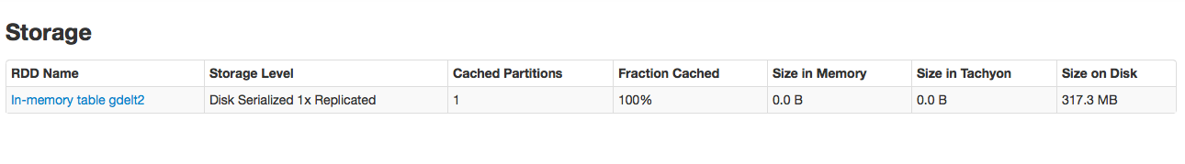


Watch how RDDs are cached
RDDs cached to disk could slow down computation
Notes:
There are many ways to run Spark. There is a standalone cluster mode, and it can run under Mesos, or YARN.

Slide 32
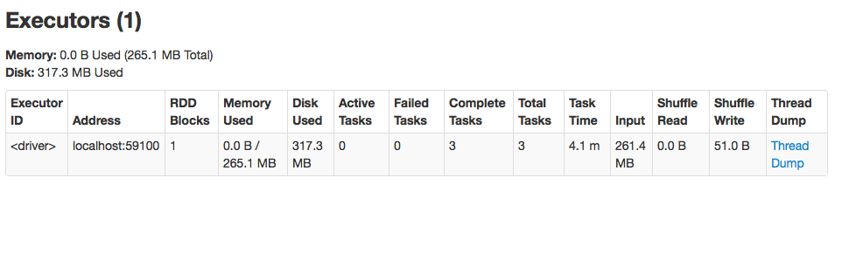
Are your jobs stuck?
First check cluster resources - does a job have enough CPU/mem?
Take a thread dump of executors:
Notes:
There are many ways to run Spark. There is a standalone cluster mode, and it can run under Mesos, or YARN.

Slide 33
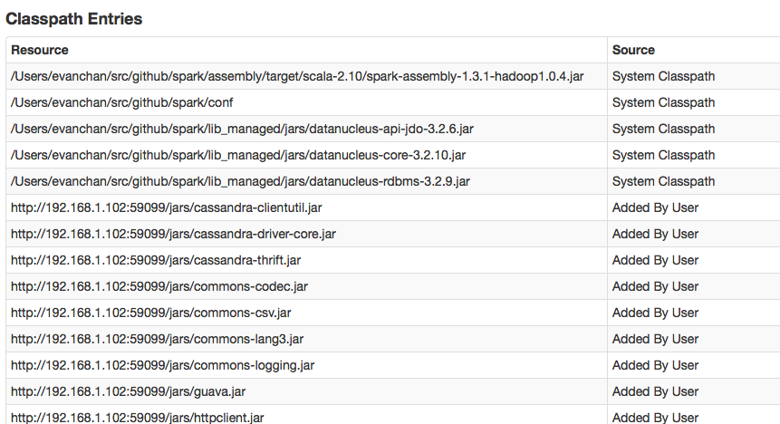
The Worst Killer - Classpath
Classpath / jar versioning issues may cause Spark to hang silently. Debug using the Environment tab of the UI:
Notes:
There are many ways to run Spark. There is a standalone cluster mode, and it can run under Mesos, or YARN.

Slide 34
Spark Job Server

Slide 35
Open Source!!
http://github.com/spark-jobserver/spark-jobserver
Also find it on spark-packages.org

Slide 36
Spark Job Server - What
REST Interface for your Spark jobs
Streaming, SQL, extendable
Job history and configuration logged to a database
Enable interactive low-latency queries (SQL/Dataframes works too) of cached RDDs and tables
Notes:
There are many ways to run Spark. There is a standalone cluster mode, and it can run under Mesos, or YARN.

Slide 37



Spark Job Server - Where
Internal users
Internet
HTTP/HTTPS
Spark Job Server
Kafka
Spark Streaming
Datastore
Spark
Notes:
There are many ways to run Spark. There is a standalone cluster mode, and it can run under Mesos, or YARN.

Slide 38
Spark Job Server - Why
Spark as a service
Share Spark across the Enterprise
HTTPS and LDAP Authentication
Enterprises - easy integration with other teams, any language
Share in-memory RDDs across logical jobs
Low-latency queries
Notes:
There are many ways to run Spark. There is a standalone cluster mode, and it can run under Mesos, or YARN.

Slide 39










Used in Production - Worldwide
Notes:
We will have 3 presentations at the upcoming Spark Summit, please be sure to watch for us.

Slide 40
Used in Production
As of last month, officially included in Datastax Enterprise 4.8!
Notes:
We will have 3 presentations at the upcoming Spark Summit, please be sure to watch for us.

Slide 41
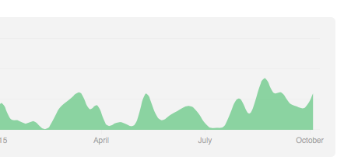

Active Community
Large number of contributions from community
HTTPS/LDAP contributed by team at KNIME
Multiple committers
Gitter IM channel, active Google group
Notes:
We will have 3 presentations at the upcoming Spark Summit, please be sure to watch for us.

Slide 42
Platform Independent
Spark Standalone
Mesos
Yarn
Docker
Example: platform-independent LDAP auth, HTTPS, can be used as a portal
Notes:
We will have 3 presentations at the upcoming Spark Summit, please be sure to watch for us.

Slide 43
Example Workflow

Slide 44
Creating a Job Server Project
In your build.sbt, add this
resolvers += "Job Server Bintray" at "https://dl.bintray.com/spark-jobserver/maven"
libraryDependencies += "spark.jobserver" % "job-server-api" % "0.5.0" % "provided"
sbt assembly -> fat jar -> upload to job server
"provided" is used. Don’t want SBT assembly to include the whole job server jar.
Java projects should be possible too
Notes:
Assuming it’s a Scala project…..

Slide 45
Example Job Server Job
/**
* A super-simple Spark job example that implements the SparkJob trait and
* can be submitted to the job server.
*/
object WordCountExample extends SparkJob {
override def validate(sc: SparkContext, config: Config): SparkJobValidation = {
Try(config.getString(“input.string”))
.map(x => SparkJobValid)
.getOrElse(SparkJobInvalid(“No input.string”))
}
override def runJob(sc: SparkContext, config: Config): Any = {
val dd = sc.parallelize(config.getString(“input.string”).split(" ").toSeq)
dd.map((_, 1)).reduceByKey(_ + _).collect().toMap
}
}
Notes:
Every job has a Config object passed in….. 400….

Slide 46
What’s Different?
Job does not create Context, Job Server does
Decide when I run the job: in own context, or in pre-created context
Allows for very modular Spark development
Break up a giant Spark app into multiple logical jobs
Example:
One job to load DataFrames tables
One job to query them
One job to run diagnostics and report debugging information
Notes:
Have the option to choose at job start time, whether to run in own context or shared context.
Pretty cool, I can submit a diagnostic jar to diagnose a problem.

Slide 47
Submitting and Running a Job
✦ curl --data-binary @../target/mydemo.jar localhost:8090/jars/demo
OK[11:32 PM] ~
✦ curl -d "input.string = A lazy dog jumped mean dog" 'localhost:8090/jobs?appName=demo&classPath=WordCountExample&sync=true'
{
"status": "OK",
"RESULT": {
"lazy": 1,
"jumped": 1,
"A": 1,
"mean": 1,
"dog": 2
}
}

Slide 48
Retrieve Job Statuses
~/s/jobserver (evan-working-1 ↩=) curl 'localhost:8090/jobs?limit=2'
[{
"duration": "77.744 secs",
"classPath": "ooyala.cnd.CreateMaterializedView",
"startTime": "2013-11-26T20:13:09.071Z",
"context": "8b7059dd-ooyala.cnd.CreateMaterializedView",
"status": "FINISHED",
"jobId": "9982f961-aaaa-4195-88c2-962eae9b08d9"
}, {
"duration": "58.067 secs",
"classPath": "ooyala.cnd.CreateMaterializedView",
"startTime": "2013-11-26T20:22:03.257Z",
"context": "d0a5ebdc-ooyala.cnd.CreateMaterializedView",
"status": "FINISHED",
"jobId": "e9317383-6a67-41c4-8291-9c140b6d8459"
}]⏎

Slide 49
Use Case: Fast Query Jobs

Slide 50
Spark as a Query Engine
Goal: spark jobs that run in under a second and answers queries on shared RDD data
Query params passed in as job config
Need to minimize context creation overhead
Thus many jobs sharing the same SparkContext
On-heap RDD caching means no serialization loss
Need to consider concurrent jobs (fair scheduling)
Notes:
Complex queries GROUP BY, filters, etc.

Slide 51
Result
Result
Create query context
Load some data
Query
Query
REST Job Server
new SparkContext
RDD
Load Data
Query Job
Query Job
Spark Executors
Cassandra
Notes:
Here we have the workflow for low-latency jobs which share a single SparkContext.
Unlike the ad-hoc job, here we explicitly create a context. With standalone / coarse mode, guarantee/fix CPU and memory resources.
We run a job to load the data and populate the SparkContext RDDs.
An API server submits query jobs against the job server, which executes them and returns JSON results in the same request.
Jobs can be separate jars, written by separate teams, independently loaded, run, tested.

Slide 52
Sharing Data Between Jobs
RDD Caching
Benefit: no need to serialize data. Especially useful for indexes etc.
Job server provides a NamedRdds trait for thread-safe CRUD of cached RDDs by name
(Compare to SparkContext’s API which uses an integer ID and is not thread safe)
For example, at Ooyala a number of fields are multiplexed into the RDD name: timestamp:customerID:granularity

Slide 53
Data Concurrency
With fair scheduler, multiple Job Server jobs can run simultaneously on one SparkContext
Managing multiple updates to RDDs
Cache keeps track of which RDDs being updated
Example: thread A spark job creates RDD “A” at t0
thread B fetches RDD “A” at t1 > t0
Both threads A and B, using NamedRdds, will get the RDD at time t2 when thread A finishes creating the RDD “A”

Slide 54
Spark SQL/Hive Query Server
Start a context based on SQLContext: curl -d "" '127.0.0.1:8090/contexts/sql-context?context-factory=spark.jobserver.context.SQLContextFactory'
Run a job for loading and caching tables in DataFrames curl -d "" '127.0.0.1:8090/jobs?appName=test&classPath=spark.jobserver.SqlLoaderJob&context=sql-context&sync=true'
Supply a query to a Query Job. All queries are logged in database by Spark Job Server. curl -d ‘sql=“SELECT count(*) FROM footable”’ '127.0.0.1:8090/jobs?appName=test&classPath=spark.jobserver.SqlQueryJob&context=sql-context&sync=true'

Slide 55



Example: Combining Streaming And Spark SQL
SQL Query
Spark Job Server
SparkSQLStreamingContext
Kafka
StreamingJob
DataFrames
SQL Query Job

Slide 56
SparkSQLStreamingJob
trait SparkSqlStreamingJob extends SparkJobBase {
type C = SQLStreamingContext
}
class SQLStreamingContext(c: SparkContext) {
val streamingContext = new StreamingContext(c, ...)
val sqlContext = new SQLContext(c)
}
Now you have access to both StreamingContext and SQLContext, and it can be shared across jobs!

Slide 57
SparkSQLStreamingContext
class SQLStreamingContextFactory extends SparkContextFactory {
import SparkJobUtils._
type C = SQLStreamingContext with ContextLike
def makeContext(config: Config, contextConfig: Config, contextName: String): C = {
val batchInterval = contextConfig.getInt("batch_interval")
val conf = configToSparkConf(config, contextConfig, contextName)
new SQLStreamingContext(new SparkContext(conf), Seconds(batchInterval)) with ContextLike {
def sparkContext: SparkContext = this.streamingContext.sparkContext
def isValidJob(job: SparkJobBase): Boolean = job.isInstanceOf[SparkSqlStreamingJob]
// Stop the streaming context, but not the SparkContext so that it can be re-used
// to create another streaming context if required:
def stop() { this.streamingContext.stop(false) }
}
}
}
To start this context: curl -d "" “localhost:8090/contexts/stream_sqltest?context-factory=com.abc.SQLStreamingContextFactory"

Slide 58
Future Work

Slide 59
Future Plans
PR: Forked JVMs for supporting many concurrent contexts
True HA operation
Swagger API documentation

Slide 60

HA for Job Server
GET /jobs/<id>
Load balancer
Job Server 1
Job Server 2
Gossip
Active Job Context
Database

Slide 61

HA and Hot Failover for Jobs
Job Server 1
Job Server 2
Gossip
Active Job Context
Standby Job Context
Checkpoint
HDFS

Slide 62
Thanks for your contributions!
All of these were community contributed:
HTTPS and Auth
saving and retrieving job configuration
forked JVM per context
Your contributions are very welcome on Github!

Slide 63

Thank you!
And Everybody is Hiring!!

Slide 64
Why We Needed a Job Server
Our vision for Spark is as a multi-team big data service
What gets repeated by every team:
Bastion box for running Hadoop/Spark jobs
Deploys and process monitoring
Tracking and serializing job status, progress, and job results
Job validation
No easy way to kill jobs
Polyglot technology stack - Ruby scripts run jobs, Go services

Slide 65
Architecture

Slide 66
Completely Async Design
http://spray.io - probably the fastest JVM HTTP microframework
Akka Actor based, non blocking
Futures used to manage individual jobs. (Note that Spark is using Scala futures to manage job stages now)
Single JVM for now, but easy to distribute later via remote Actors / Akka Cluster

Slide 67
Async Actor Flow
Spray web API
Local Supervisor
Request actor
Job Manager
Job Status Actor
Job 1 Future
Job Result Actor
Job 2 Future

Slide 68
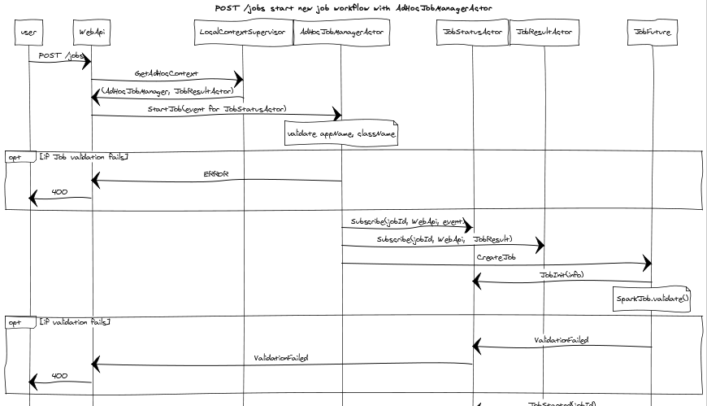
Message flow fully documented

Slide 69
Production Usage

Slide 70
Metadata Store
JarInfo, JobInfo, ConfigInfo
JobSqlDAO. Store metadata to SQL database by JDBC interface.
Easily configured by spark.sqldao.jdbc.url
jdbc:mysql://dbserver:3306/jobserverdb
Multiple Job Servers can share the same MySQL.
Jars uploaded once but accessible by all servers.
The default will be JobSqlDAO and H2.
Single H2 DB file. Serialization and deserialization are handled by H2.

Slide 71
Deployment and Metrics
spark-jobserver repo comes with a full suite of tests and deploy scripts:
server_deploy.sh for regular server pushes
server_package.sh for Mesos and Chronos .tar.gz
/metricz route for codahale-metrics monitoring
/healthz route for health check

Slide 72
Challenges and Lessons
Spark is based around contexts - we need a Job Server oriented around logical jobs
Running multiple SparkContexts in the same process
Better long term solution is forked JVM per SparkContext
Workaround: spark.driver.allowMultipleContexts = true
Dynamic jar and class loading is tricky
Manage threads carefully - each context uses lots of threads

